Slide 1
QCIPN CLINICAL CARE COORDINATION PROGRAM A Team-Based Model of Care
Mia Taylor MSN, FNP-BC, APRN-Rx
Director, Community & Post-Acute Care Services
Clinical Care Coordination & Transitional Case Management

Slide 2
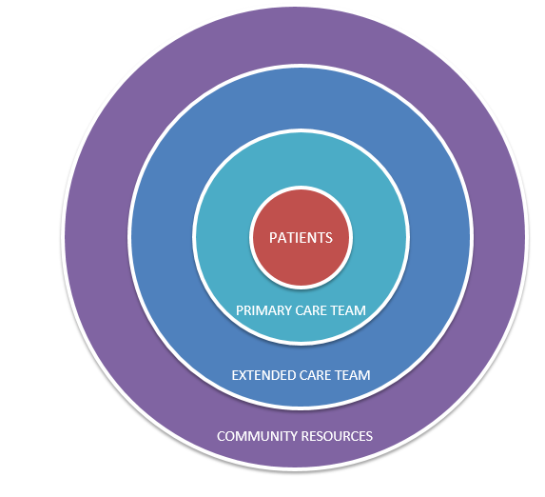
TEAM-BASED MODEL OF CARE
EXTENDED CARE TEAM
Social Worker
RN Case Manager-complex
CHW/Navigator
Health Coach
Dietician
Pharmacist
Psychiatrist
COMMUNITY RESOURCES
Skilled Nursing Facilities/
LTC Facilities
Home Care /Home Infusion
Agencies
Hospice/Palliative Care Agencies
Behavioral Health/Substance Use Support
Community Pharmacists
Physical Therapy
Urgent Care
Payers
PRIMARY CARE TEAM
Physician (MD)
Nurse Practitioner (NP)
Provider Practice Assistant
(PPA/MA)
Registered Nurse (RN)

Slide 3
QCIPN CCC Health Coach Responsibilities
Guide patients through the stages of change. Engage in change talk, individualized approach to supporting the patient’s goals
Regular patient check-ins (asynchronous & synchronous) via different modalities based on patient preference
As needed, support patients in learning to use monitoring devices such as for blood pressure, blood glucose and weight
As needed and established by protocol coordinate patient visits with pharmacist, physician, and/or additional health system resources

Slide 4
TRANSITIONAL CASE MANAGEMENT PROGRAM
Provides telephonic support for 30 days for patients discharging from Punchbowl, Queen's West Oahu, and Molokai General & North Hawaii Community Hospitals
Support for high, risk-high needs patients from the acute care setting to the next level of care via a warm handoff from the inpatient teams including:
High risk diabetes
Stroke -supporting the advanced stroke certification workflow
Heart failure- supporting the inpatient and ambulatory Heart Failure Team
Palliative care
Geriatrics
Queens Coalition – ED hyper-utilizers
Afib, Cellulitis, CKD and COPD pathways

Slide 5
TCMP CHW Practicum Student Responsibilities
Assist with appointment scheduling and reminders
Arrange transportation
Coordinate to obtain medication, equipment and supplies
Provide resource material via MyChart, email, mail
Coordinate outpatient services such as Home health, OT/PT/ST
Linkage to community resources such benefit assistance, referring to health coordinators and mental health
Patient Advocacy/support to caregivers/family
Assist RNs and SWAs with urgent needs and follow up for patients
ED follow up calls
And more!

Slide 6
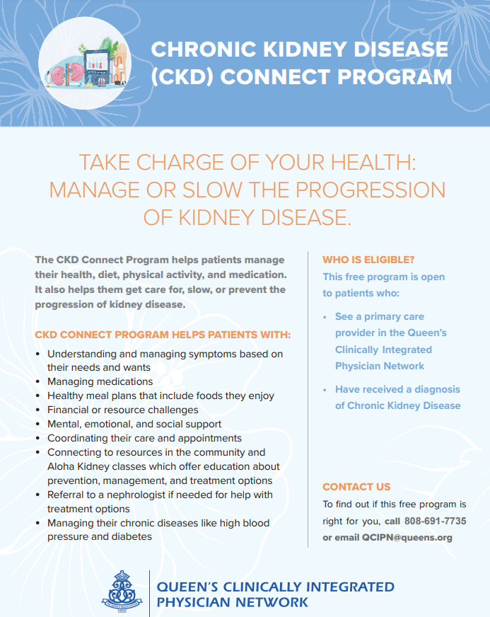
CHRONIC KIDNEY DISEASE (CKD) CONNECT
Assessment, Care Plan Development and Clinical Monitoring.
Health mentors perform telephonic, telehealth or face-to-face visit to provide teaching, follow patients over time, monitor progress and share results with providers
Provide disease specific care coordination and education
Manage contributing factors- hypertension and diabetes
Typical Patient Profile:
CKD Stage 3-5
Complex medical/psychosocial needs
Needs additional disease specific education and support
Would benefit from goals of care and ACP

Slide 7
SMOKING CESSATION PROGRAM
Quit Support and Education
Provides resources, one-to-one support, community resources, and interdisciplinary education on making this healthy lifestyle change supported by:
Program Coordinator/Educator
Pharmacist
Behavioral Health Team
Typical Patient Profile
Current smoker or vaper
Willingness to quit

Slide 8
OLA HOU I KA HULA: RESTORE HEALTH THROUGH HULA
FREE 6-Month Virtual Hula Cohort
Hypertension Education sessions supported by:
Pharmacist
Dietitian
RN
Typical Patient Profile:
Adults 18 and older with a documented diagnosis of hypertension
No hula experience is necessary

Slide 9
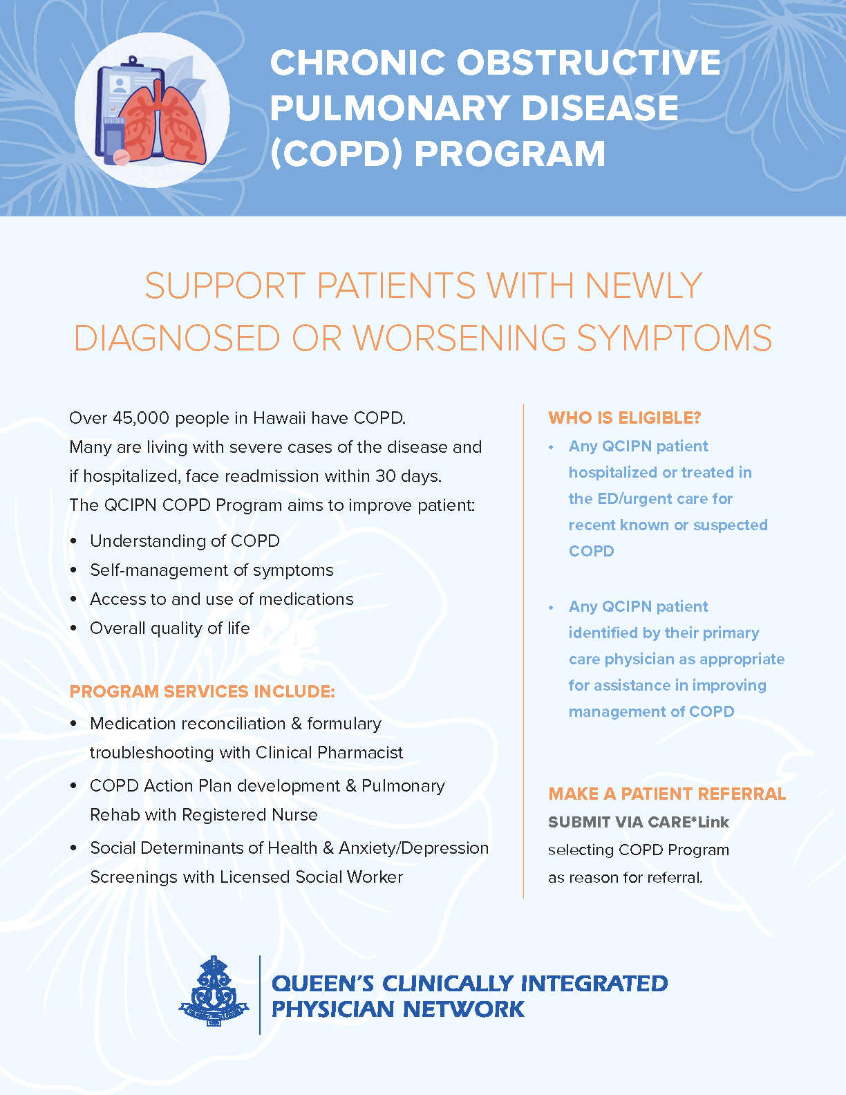
CHRONIC OBSTRUCTIVE PULMONARY DISEASE (COPD) PROGRAM
Assessment, Care Plan Development, and Clinical Monitoring.
Health mentors perform telephonic, telehealth or face-to face visit to provide teaching, follow patients over time, monitor progress and share results with providers
Support patients with newly diagnosed or worsening symptoms
Typical Patient Profile:
Has had hospitalization or treated in ED/urgent care for recent, known or suspected COPD
Needing assistance in improving COPD management
Newly diagnosed or identified as needing assistance or support in the ambulatory setting

Slide 10
Health Information Technology Support
Patient Identification
High Risk- High Need- clinical data, claims data
High utilizers
Undiagnosed Hypertension and Diabetes algorithms
Standardized SDoH screening
Patient Engagement
Working with HHIE to identify patients seen in the ED and Inpatient in real time and outreach during that “teachable moment”
Identifying patients not seen by PCP
Identify patients with non- adherent concerns

Slide 11
What’s Next?
Continue to expand the Health Coach role
Continue to expand the CHW/Navigator Role
Continue to work on engagement initiatives
RPM platform
Continue to partner with community preventative health initiatives
DOE, DOH, UH Keiki programs
Continue to explore data algorithms to help identify patients at risk
Stroke Algorithm Project, Paul Coverdell National Acute Stroke Program.

Slide 12
MAHALO

